Slide 1


Welcome to SAP Inside Track Newtown Square 2018

Slide 2

SAP Inside Track
Local grassroots community events, assisted by SAP Mentors (if local)
Supported by the SAP Community Network
Oftentimes Inside Tracks are sponsored by SAP or others in the SAP ecosystem
Allows for dedicated space, catering and other cool things
You can create your own Inside Track or volunteer to help make SITNSQ 2019 even bigger and better
Find any SAP Mentor to volunteer with planning (or sponsoring)
Check out the Inside Track homepage for more info

Slide 3
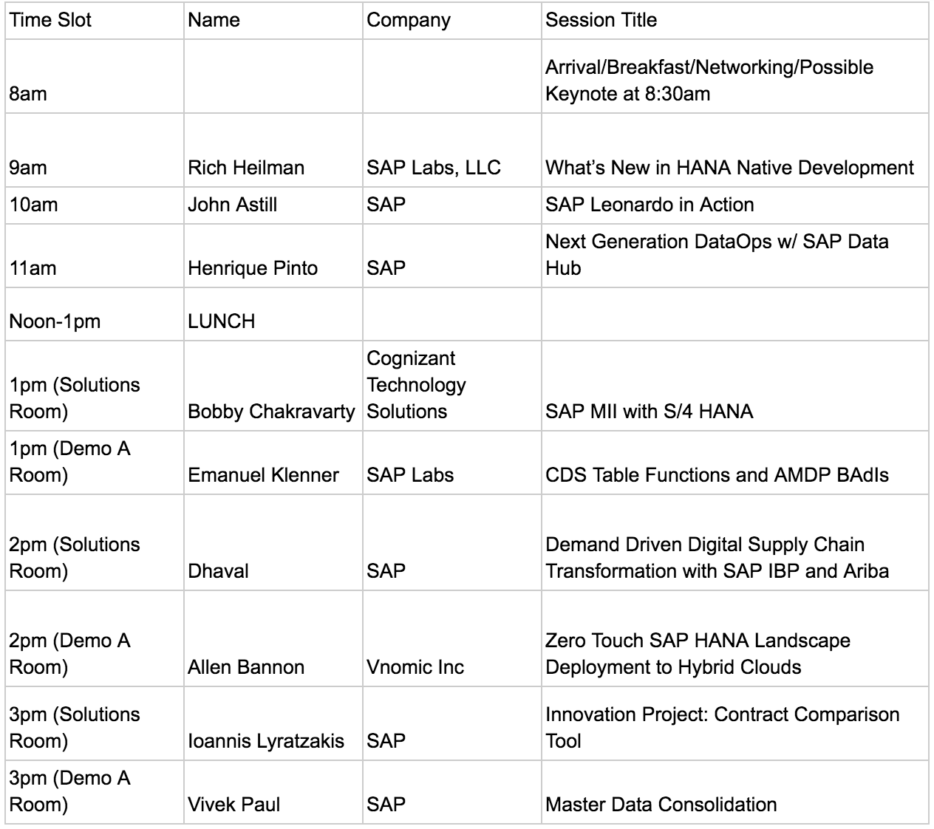
Agenda

Slide 4
Housekeeping
Morning sessions aka ‘Morning with the SAP Mentors’: NSQ Auditorium
Lunch & Afternoon Sessions: Third Floor Executive Briefing Sessions
Sessions: Solutions Room + Demo Room A Lunch: Valley Green (between Solutions & Demo Room A)
WiFi access via SAP-Guest network

Slide 5
Appreciation
Logistics: SAP Executive Briefing Center Team
Meals: SAP Mentor Program & John Appleby (HANA Centers of Excellence)
Planning Committee: Rich Heilman (SITNSQ Chairman Emeritus), John Astill, Greg Myers, Peter McNulty, Caetano Almeida, John Appleby, Henrique Pinto
Speakers: Rich Heilman, John Astill, Henrique Pinto, Bobby Chakravarty, Emanuel Clenner, Dhaval Desai, Allen Bannon, Ioannis Lyratzakis, Vivek Paul
Keynote: John Appleby
Sponsor: SAP Press

Slide 6

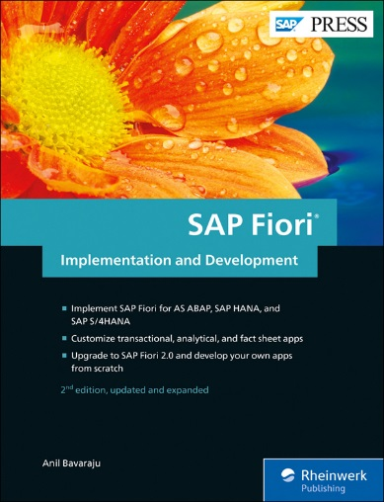
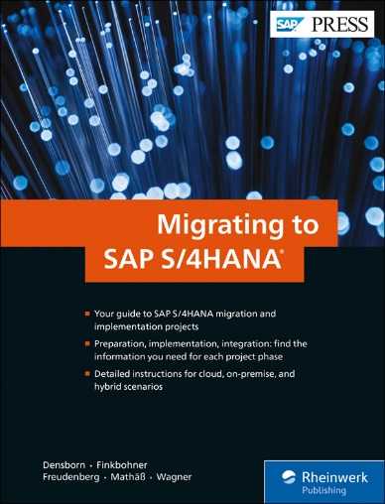
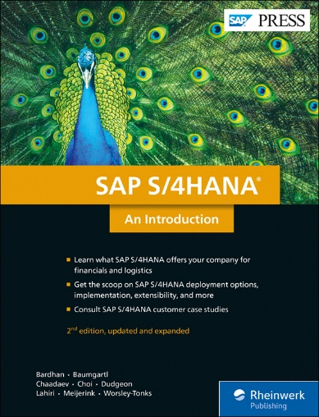

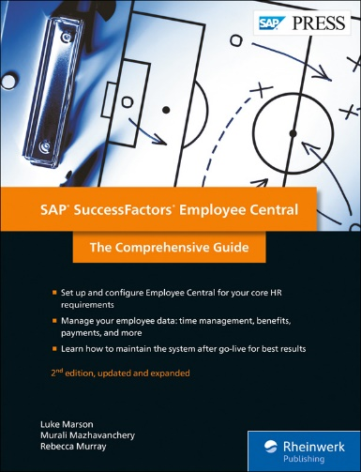
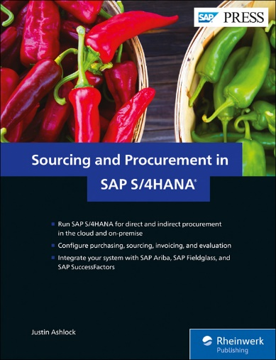
Leading SAP Publisher
Need the best SAP information from the best SAP experts? Only SAP PRESS can give you the authority that comes from being the leading SAP publishing partner. Whether you're an SAP newbie or a lifer, we've got the books you need to stay on top of your game.
Find the latest and upcoming SAP PRESS
releases at www.sap-press.com!
Notes:
I predicted a “precision landing”, and:
We did it! (Again!)
How?
-> very strong backlist
-> SAPPHIRE
Still one title behind, we could be right on track!

Slide 7
Win a Free SAP PRESS E-Book of Your Choosing!
Select from more than 200 active titles!
Find the latest and upcoming SAP PRESS releases at www.sap-press.com!
Notes:
I predicted a “precision landing”, and:
We did it! (Again!)
How?
-> very strong backlist
-> SAPPHIRE
Still one title behind, we could be right on track!

Slide 8

SAP Mentors Program
Presented by the SAP Mentors Program

Slide 9
SAP Mentors Program
Global influencer program that identifies and recognizes exceptional and high-value members of the larger SAP ecosystem to keep SAP relevant.
NA
28%
EMEA
42%
LA
8%
APJ
20%
MEA
1%

Slide 10
SAP Mentors Program
123 Mentors worldwide working for Customers, Partners, or Consultants. All of them are hands-on experts of an SAP product or service, as well as champions of community-driven projects.
Independent Consultants
28%
Partners
42%
University Alliance
2%
Customers
27%

Slide 11



SAP Mentors Program
ENGAGE
CO-INNOVATE
ADVOCATE
INFORMING and EDUCATING the market on the opportunities SAP technology offers
NURTURING community activity and engagement over local meet-ups and community webinars
VALIDATING go-to-market messaging and improve services and solutions
Credible INFLUENCERS and advocates for SAP technology
Close PARTNERSHIP with SAP, operating under NDA
Notes:
Why Mentors Matter

Slide 12

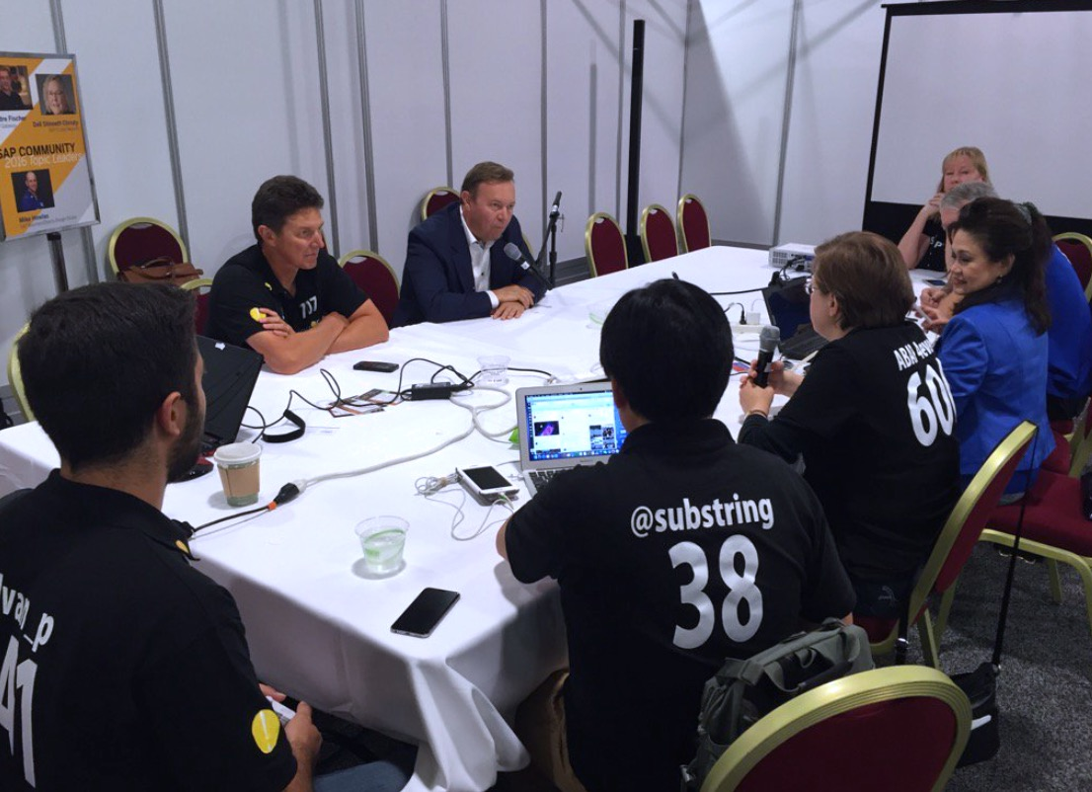
Engagement, Co-Innovation, Advocacy
PRODUCT SUPPORT
How Mentors Matter
Shape next-generation support tools such as Support Portal and Expert Chat
Exchange news about the latest developments and customer experiences with Support Executives
Publish a bi-annual Point of View Document

Slide 13
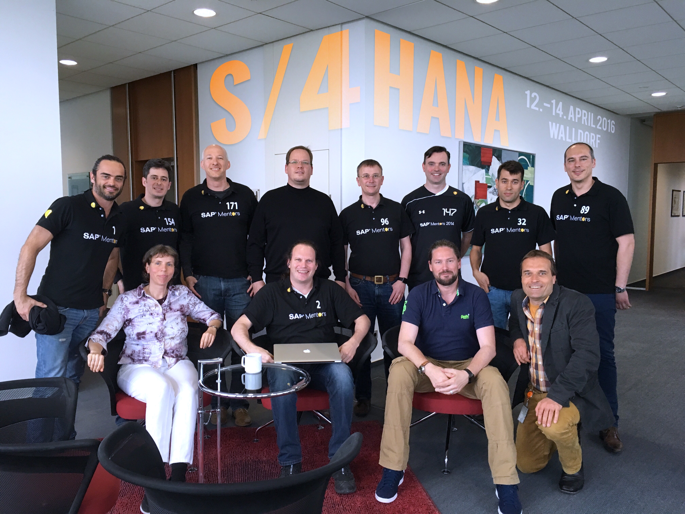
Engagement, Co-Innovation, Advocacy
SAP S/4 HANA
How Mentors Matter
Share technical and market insights with the S/4HANA team
Attend SAP S/4 HANA Validation workshop event in Waldorf twice each year
Collaborate with the Product Management team to review and validate strategy, roadmap and requirements prioritization.

Slide 14
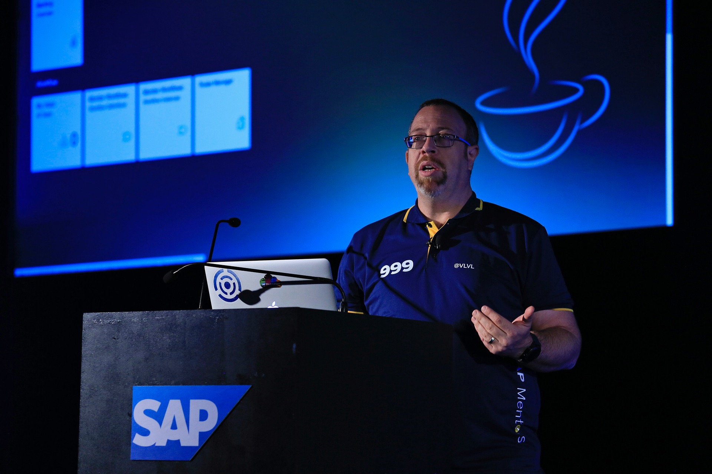
Engagement, Co-Innovation, Advocacy
SAP PREMIER EVENTS & SAP INSIDE TRACKS
How Mentors Matter
Share knowledge in customer panels, interviews and as lecturers at TECHED and SAPPHIRE NOW
Host and organize community events in cities around the world called SAP Inside Tracks
SAP customers and partners can chose from 20-30 SAP Inside Tracks events each year

Slide 15
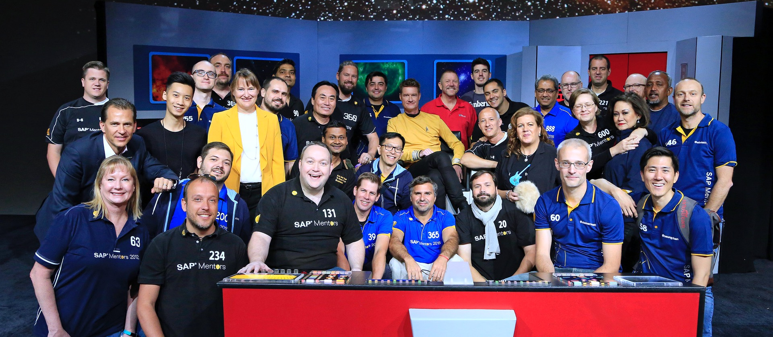
SAP Mentors Program
What does SAP CTO Bjoern Goerke have to say about the Mentors?
https://www.youtube.com/watch?v=G007Ckak0n8

Slide 16

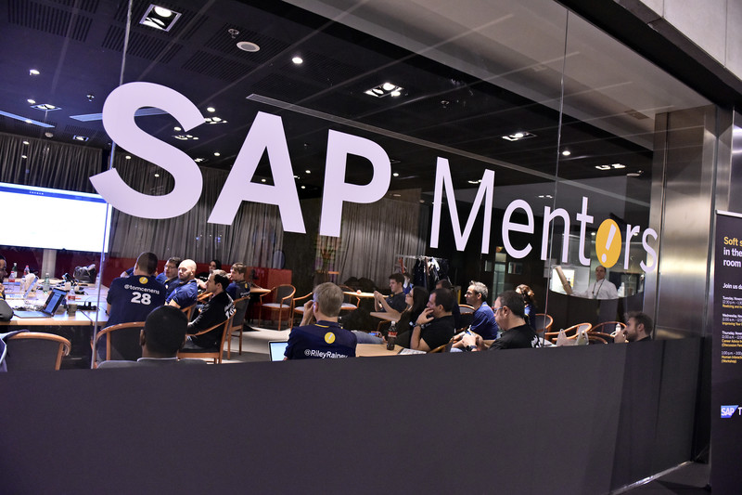
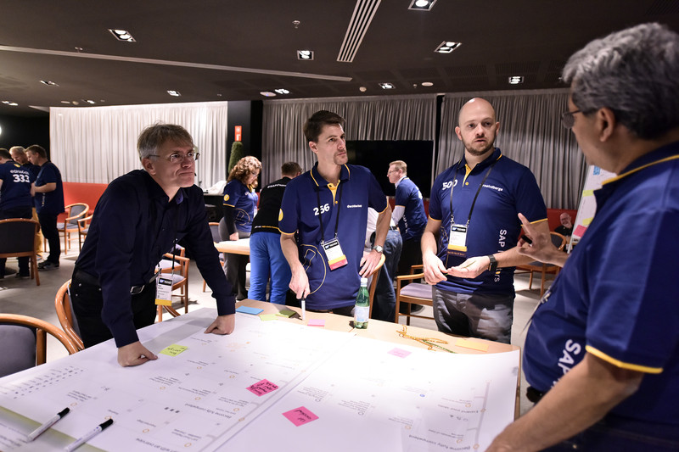
Take the next step
Find out more about the SAP Mentors Program http://sapmentors.sap.com
Hear from SAP Mentors directly https://www.youtube.com/watch?v=wJj7WlKFXao&feature=youtu.be
Consider becoming an SAP Mentor https://blogs.sap.com/2016/03/01/sap-mentors-wanted/
Nominate someone today or submit an application for yourself http://bit.ly/BeSAPMentors

Slide 17
Thank You

Slide 18
SITNSQ18 Keynote Speaker
John Appleby

